Slide 1
Hypothesis Testing and Logistic Regression Introduction

Slide 2
Learning Objectives
After completion of today’s session you will be able to:
Explain hypothesis testing in regression
Describe the concept binary outcomes and its relevance with logistic regression

Slide 3
Agenda
Inferencing Coefficients
Hypothesis Testing and p-values
Introduction to Binary Outcomes

Slide 4
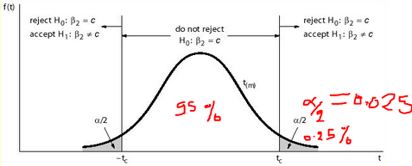
Making Inferences about Coefficients: whether a particular predictor has any effect on the response variable
Can we conclude that the size of a house (X) is linearly related to its selling price (Y) at 95% confidence level ?
α=0.05, n=9
Test H₀ : b₁ = 0
(b1 has no effect on y)
versus H_{A} : b₁ ≠ 0
(b1 has effect on y)
Calculate t-statistic T = b1/s(b1) = 4.12/ 0.789 = 5.22
If T < - t_{(n – 2 , α} _{/ 2)} or T > + t_{( n – 2 ,} _{α / 2} ₎ , we reject H₀.
T critical value (refer the Table) : t_{(7, 0.025)} = ± 2.365
α/2=2.5%
-t _{(n-2,α/2)}
t _{(n-2,α/2)}

Slide 5
Agenda
Inferencing Coefficients
Hypothesis Testing and p-values
Introduction to Binary Outcomes

Slide 6
Overall Significance Tests
The F-test of overall significance indicates whether your linear regression model provides a better fit to the data than a model that contains no independent variables.
It compares a model with no predictors to the model that you specify.
A regression model that contains no predictors is also known as an intercept-only model.
Null hypothesis: The fit of the intercept-only model and your model are equal.
Alternative hypothesis: The fit of the intercept-only model is significantly reduced compared to your model.
Notes:
<number>

Slide 7
F statistic
Compute as follows:
3. MSE=SSE/df1 , MSR= SSR/df2
4. F value: F=MSR/MSE
5. F-critical= f_{(α,df1,df2)}
5. Define the Hypothesis
6. If F-value > F-critical, reject the H0
OR If F-significance (P-value) <
^
1. SSE = ∑ ( y_{i} – y_{i} )² (Sum of squared error or residual error, measure of unexplained variation, df1=n-p, where p is number of parameters)
2. SSR = ∑ ( y – y_{i} ) ² (Sum of squared Regression, measure of explained variation, df2=p-1)
^
Notes:
Find a (1 - α)100% confidence interval I using an F-table
7. Accept the null hypothesis if F ∈ I; reject it if F ∉ I.
<number>

Slide 8
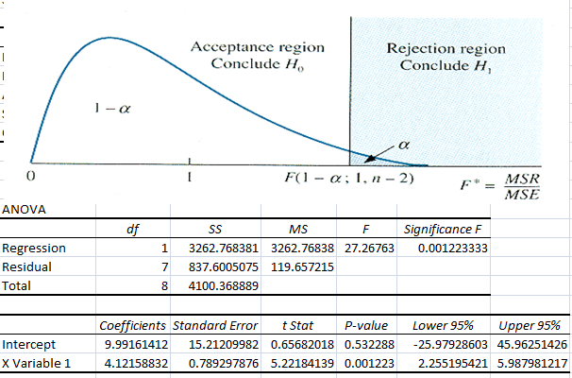

Slide 9
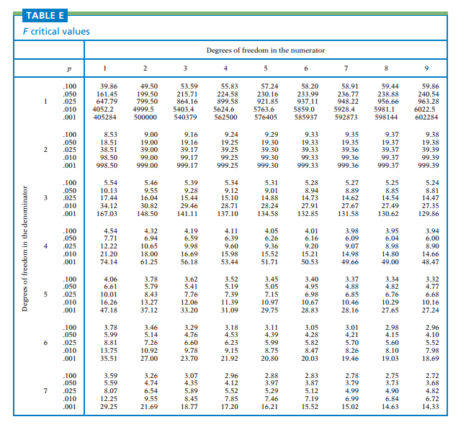

Slide 10
Hypothesis test using P value-Alternate method
If the P-value for the F-value (F=MSR/MSE) is less than your significance level (α ), we can reject the null-hypothesis and conclude that your model provides a better fit than the intercept-only model.

Slide 11
Agenda
Inferencing Coefficients
Hypothesis Testing and p-values
Introduction to Binary Outcomes

Slide 12
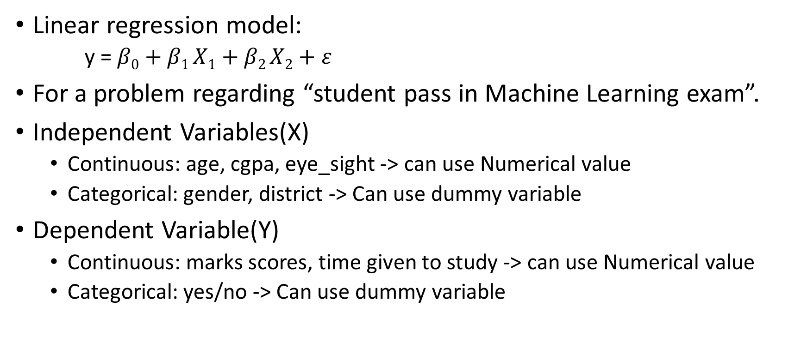
Recap – Continuous VS Categorical Variable

Slide 13
Representing Binary Outcomes
There are two outcomes possible: Yes or No
We can create a dummy variable to indicate Yes and No:
y = 1, if Yes
y = 0, if No

Slide 14
Example Data:
Suppose we have the information of all the 360 students studying Machine Learning. We want to know what determines whether they will pass in Machine Learning in Monthly test.
Pass(y): Whether student is passed or not
Hours(x): We will start examining how studying hours(in 4 weeks) influences the likelihood of passing.

Slide 15
Linear model
After the analysis we got;
Pass = -1.700 + 0.064 Hours
Interpreting the result:
P(Pass = 1) = p = -1.700 + 0.064 Hours

Slide 16
References
[1] https://statisticsbyjim.com/regression/interpret-f-test-overall-significance-regression/

